Slide 1


Classification of Documents Using KNN And Graph
Presented By:
Muhammad Usman Asghar 2021-CS-46
Yahya Muhammad Mirza 2021-CS-11

Slide 2
Introduction
Objective
Overview of methodology
Importance of Document Classification

Slide 3
Data Presentation
Data Collection
Data Division (Training & Test)

Slide 4
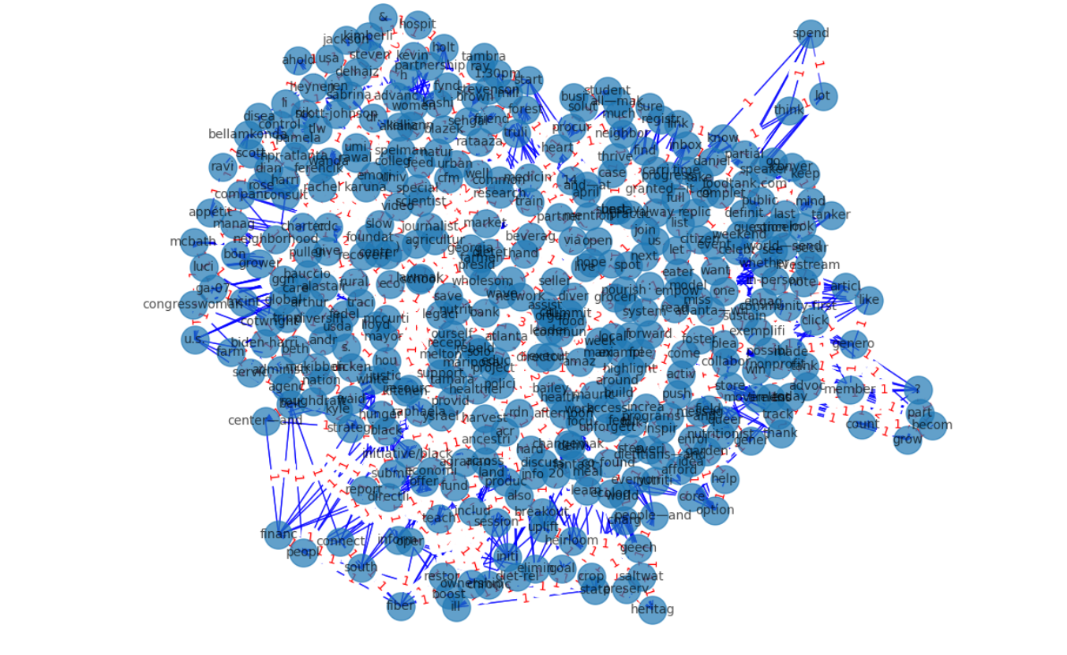
Graph Construction
Nodes Representation
Edges Description
Graph Visualization

Slide 5
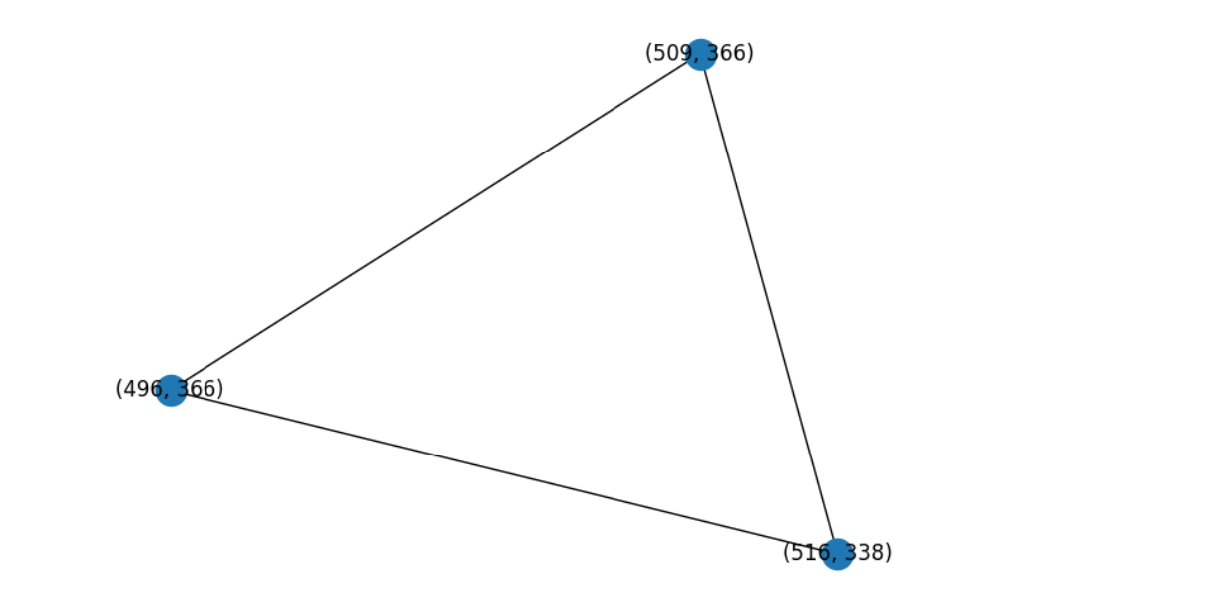
Subgraphs
Mine
Identify
Features

Slide 6
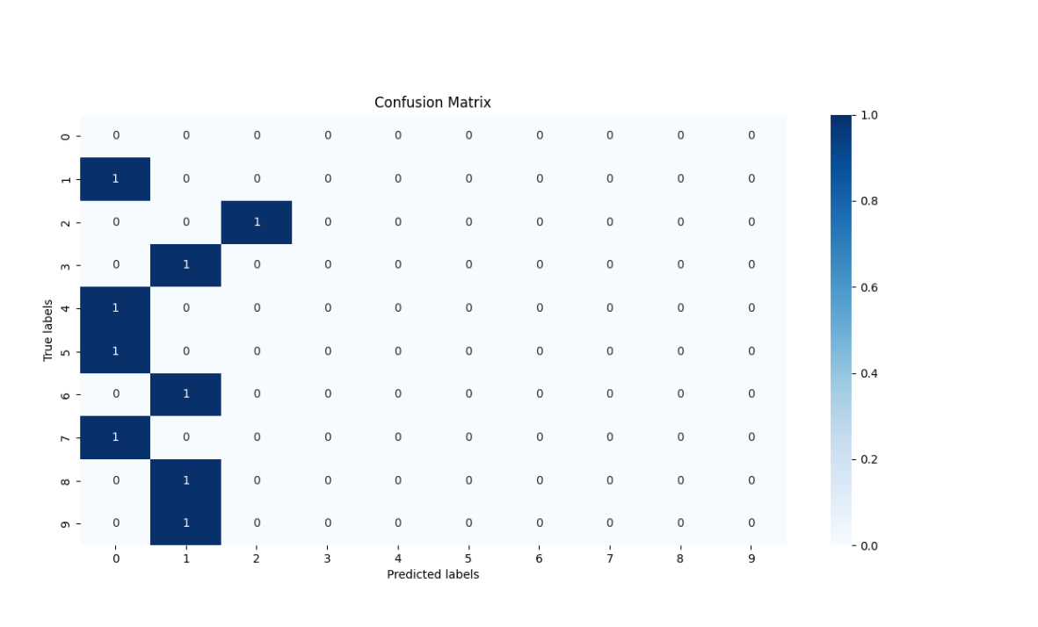
KNN
KNN Implementation
Distance Measure (MCS)
Document Classification

Slide 7
Evaluation
Accuracy Assessment
Precision Calculation
Recall Evaluation

Slide 8
Results
Performance Comparison
Graph-Based vs. Vector-Based
Advantages Highlighted

Slide 9
Challenges
Complexity of graph
Optimization of KNN

Slide 10
Improvement
Graph Structure Method
Alternative Algorithm
Large scale Dataset

Slide 11
Implication
Enchanced Classification Model
Research Graph Representation
Adoption of Graph Features

Slide 12
Conclusion
Summary
Significance

